Slide 1
Decarbonising a University using a Science Based Target approach
Sally Pidgeon – Deputy Head of Sustainability

Slide 2
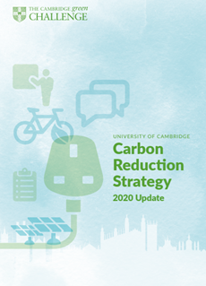
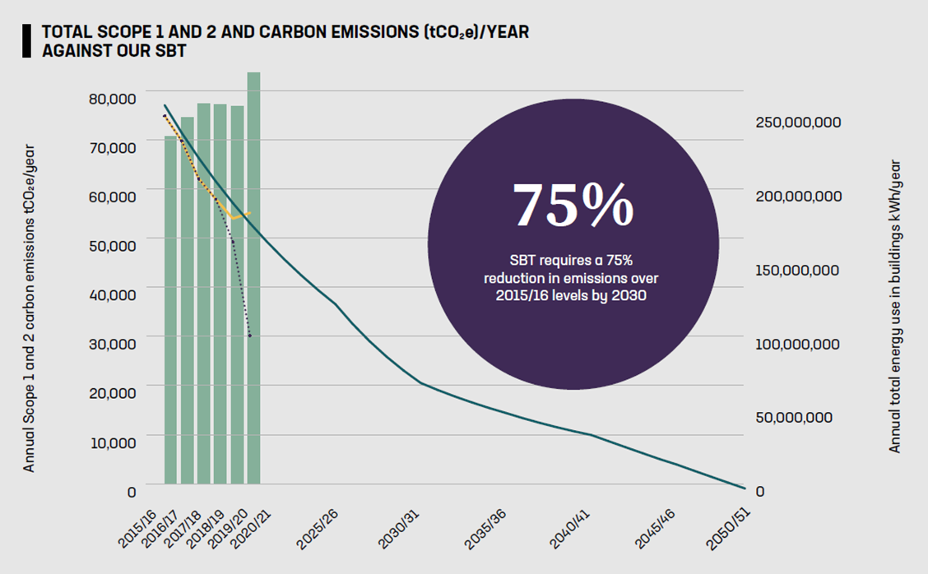
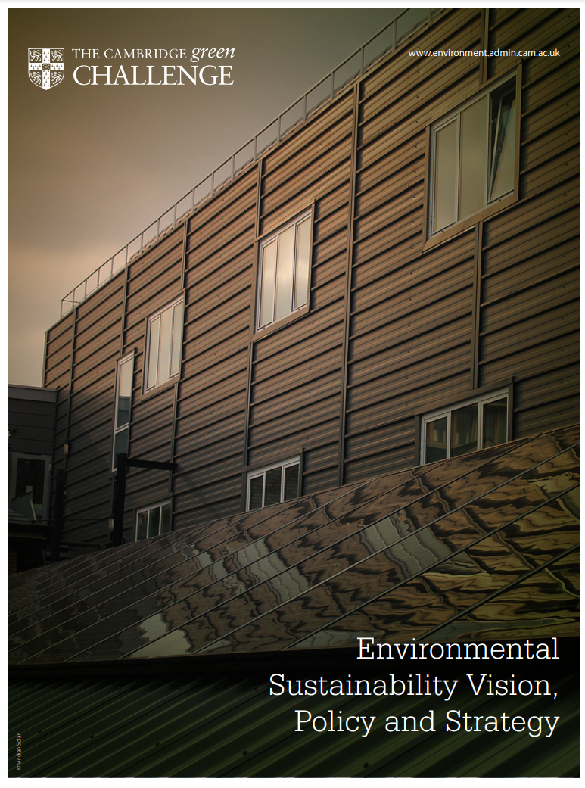

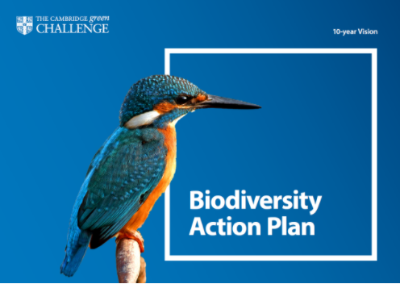
Strategic context
Notes:
University is committed to making a positive impact through outstanding environmental sustainability performance.

Slide 3

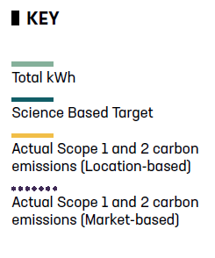
Our Science Based Target

Slide 4
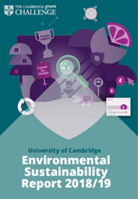
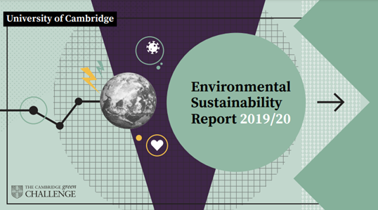
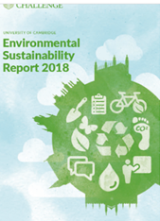
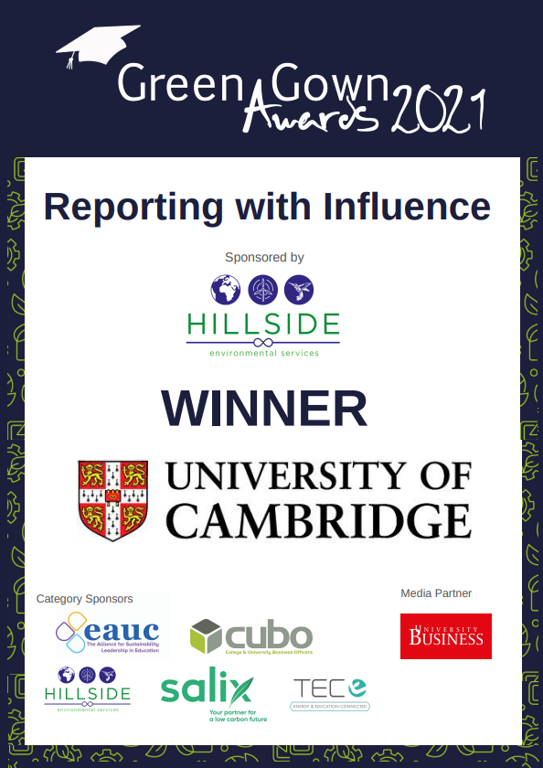
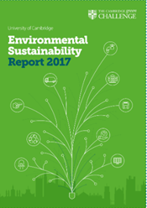
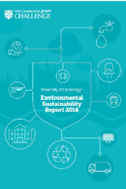
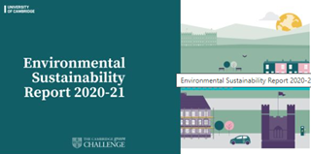
Annual Environmental Sustainability Report

Slide 5
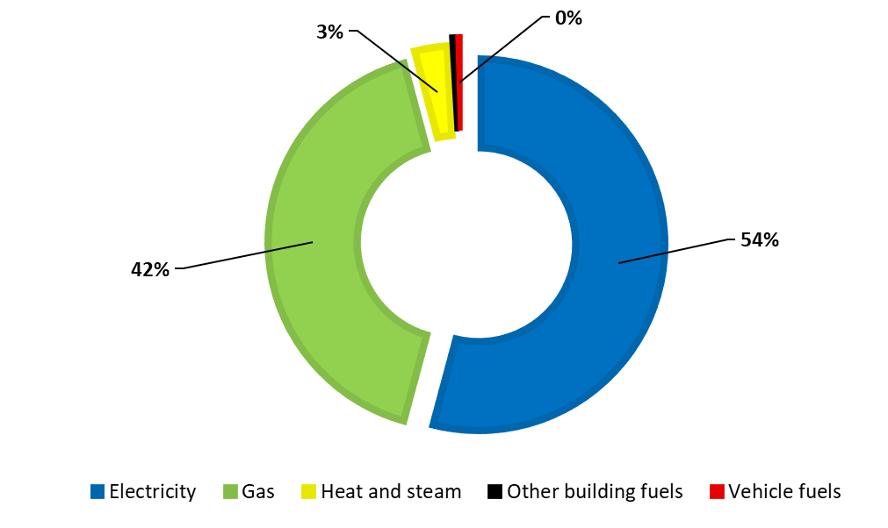
Carbon footprint 2020/21
Scope 1 and 2 carbon emissions: 55,106 tCO₂e (Location based figure)

Slide 6
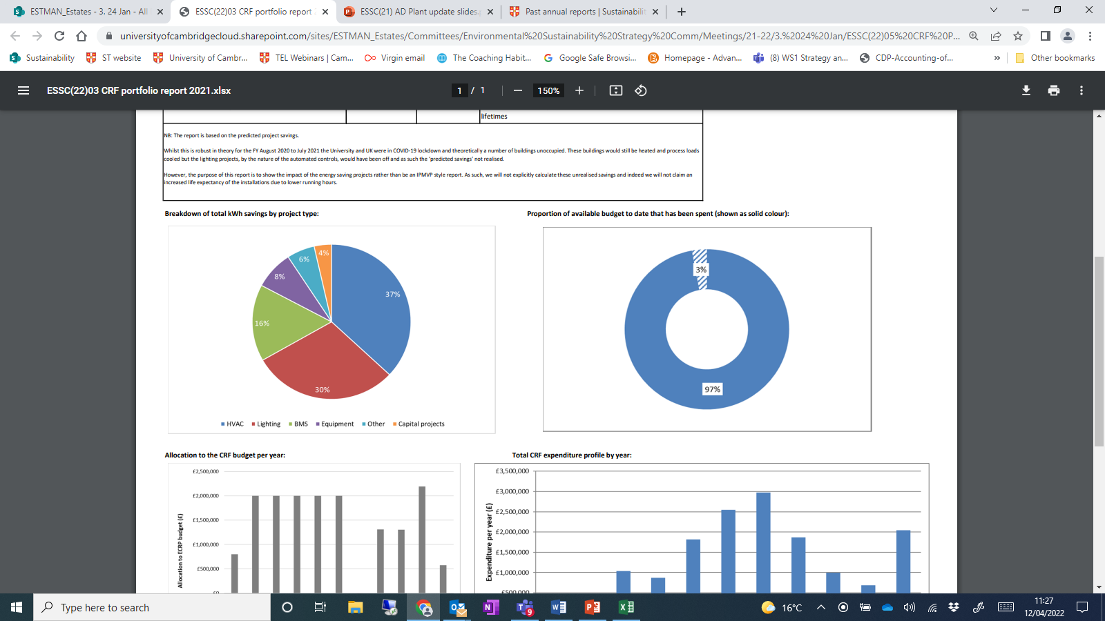
Carbon Reduction Fund
Since 2011
Total expenditure to date:
£12.2M
Estimated lifetime cost
  avoidance:
  £26.6M

Slide 7
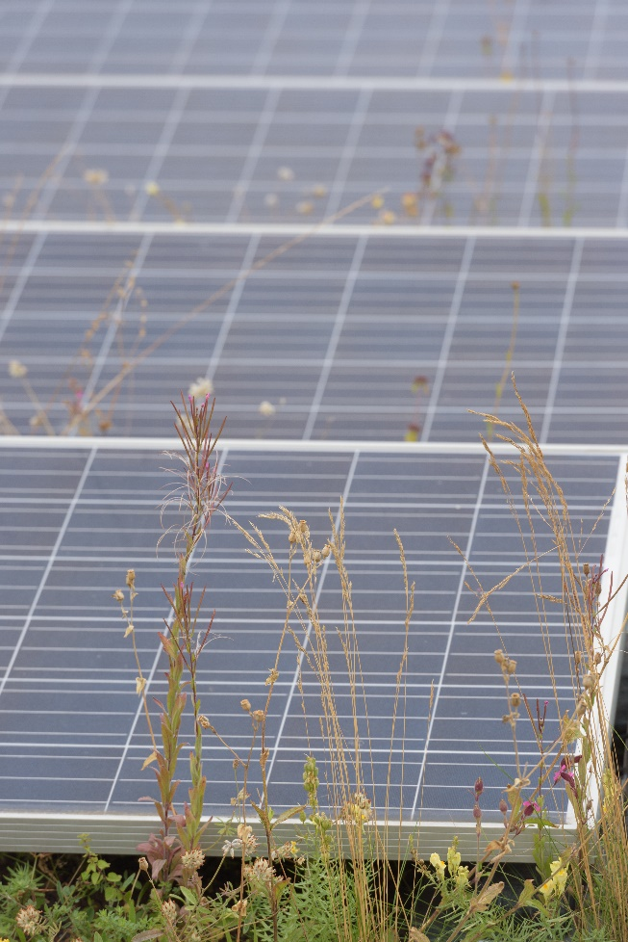
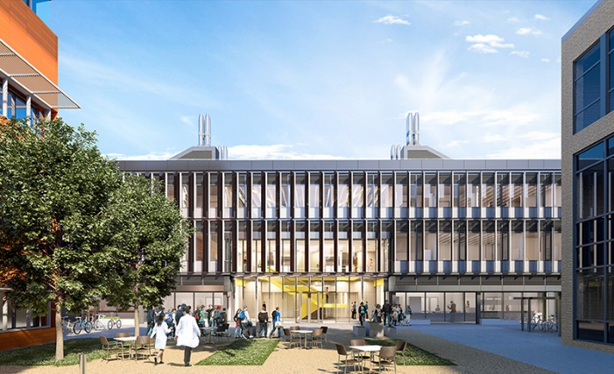
Main building blocks to zero carbon
Power Purchase Agreement for zero carbon electricity
Increasing onsite electricity generation
Removing gas from the estate
Capital programme – incorporating carbon into decision making
Cultural and behavioural change

Slide 8
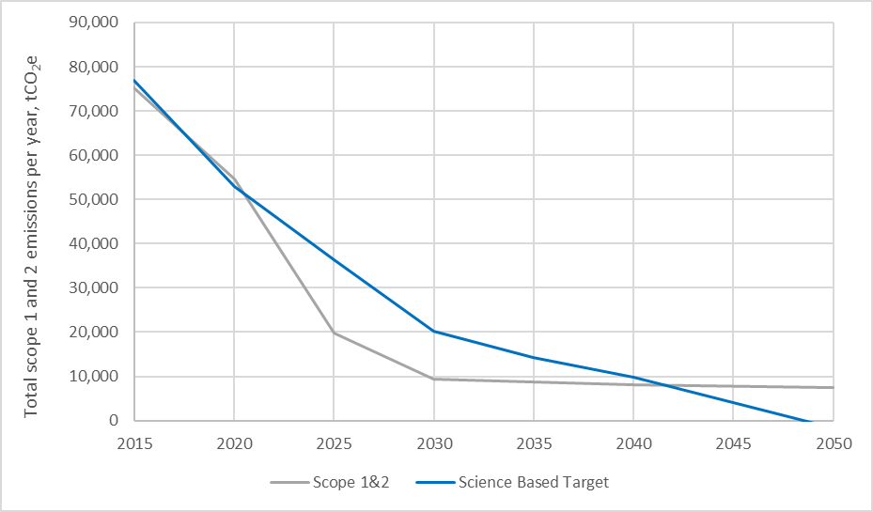
Opportunities: Reshaping the Estate for sustainability
Forecast annual scope 1 and 2 emissions under an ambitious carbon reduction programme, with size of the estate maintained at 2020 level
Graph shows SBT (blue line) and total scope 1 and 2 emissions (grey line) if the University does all of the following by 2050:​
Generates 50% of all of its electricity from onsite renewables​
Purchases remaining 50% of electricity from certified renewable sources (Power Purchase Agreements)​
Shifts 50% of its heat demand from gas to electricity​
Achieves a 30% improvement in the thermal efficiency of its buildings​

Slide 9
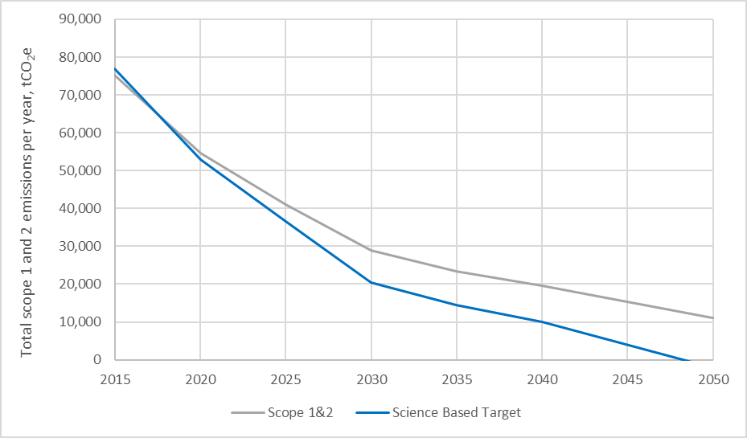
Reshaping the Estate for sustainability
Forecast annual scope 1 and 2 emissions under an estate that decreases by 1% per year on average, and with no investment in direct carbon reduction measures
Graph shows that the University could achieve a similar level of carbon reduction by reducing the size of its estate by 1% per year (based against 2017/18 GIA) until 2050​
This is without doing any other carbon reduction measures – i.e. maintaining BAU in all other respects​

Slide 10




Sally Pidgeon
Deputy Head of Sustainability
Sally.Pidgeon@admin.cam.ac.uk
www.environment.admin.cam.ac.uk
/Cuenvironment
@CambridgeSust
cambridgesust

